Slide 1
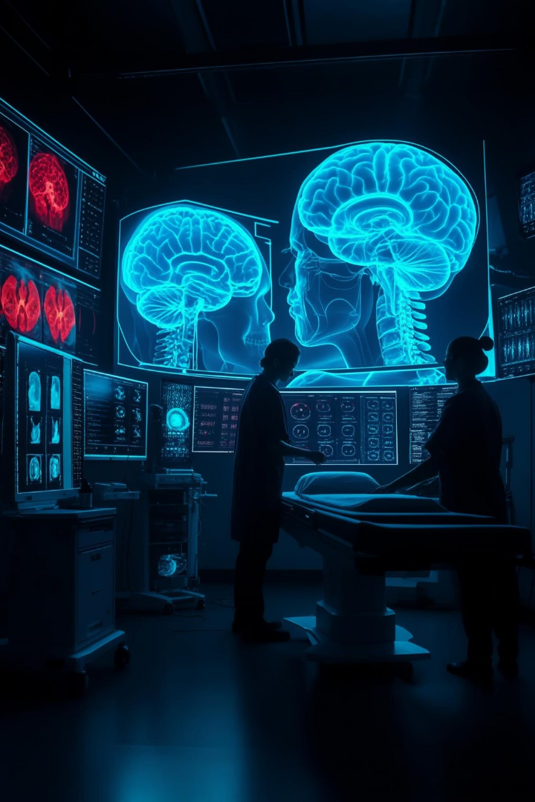
Stroke Prediction from Brain Scans Using Python
A PROJECT REPORT – SUBMITTED BY
S.ASHOK - 420121104006
V.DINESH - 420121104020
S.RAMADOSS - 420121104045
S.SHEIK AMJATH - 420121104050
UNDER THE GUIDENCE OF : Mrs.N.ABINAYA M.E

Slide 2
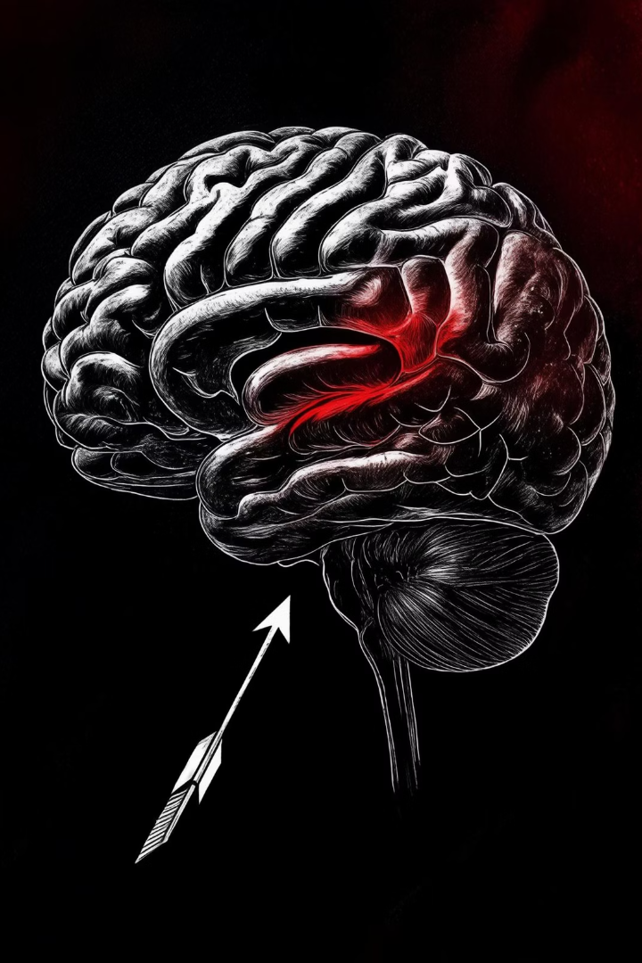
The Importance of Early Stroke Prediction
795K
US Strokes Annually
A leading cause of long-term disability and death.
$73.7B
Annual US Cost
Strokes impose a significant financial burden.
Early prediction enables timely intervention. It reduces damage and improves recovery.

Slide 3
Data Sources: Brain Scan Imaging
Imaging Modalities
Public Datasets
Key Features
CT scans, MRI, and angiography provide critical data. They offer structural and functional information.
ADNI and STIR are invaluable resources. They contain diverse brain imaging data.
We identify lesions, white matter changes, and blood flow abnormalities. These are crucial for prediction.

Slide 4
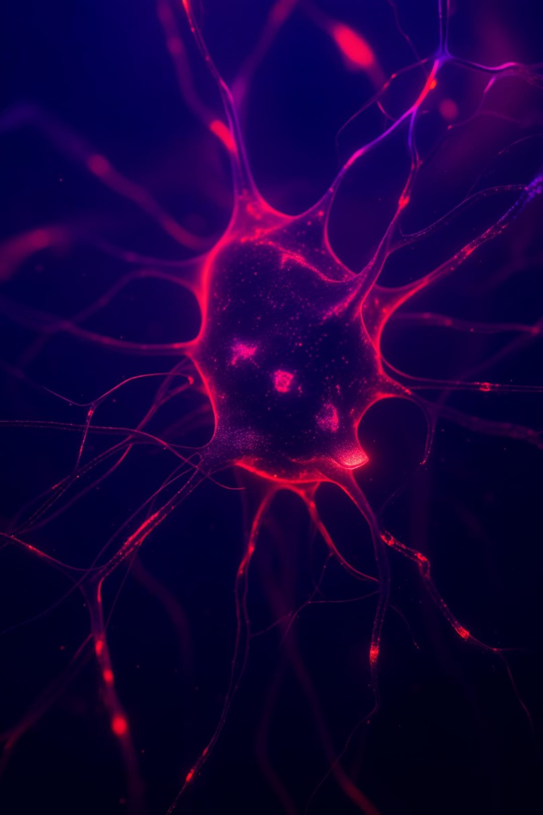
Machine Learning Techniques for Stroke Prediction
Classification Algorithms
Logistic Regression, SVM, and Random Forests classify risk. They provide robust predictions.
Deep Learning
CNNs analyze complex image patterns. They excel in feature recognition.
Feature Extraction
Identifying relevant biomarkers is key. It refines prediction accuracy.
Explainable AI (XAI)
Ensuring transparency builds trust. It makes predictions understandable.

Slide 5





Python Implementation and Libraries
Python
Deep Learning
Scikit-learn
The go-to language for data science. It is powerful and flexible.
TensorFlow, Keras, PyTorch build robust models. They enable complex analysis.
Traditional ML algorithms and tools. They provide versatility.
Image Processing
OpenCV and SimpleITK handle image data. They preprocess and analyze scans.

Slide 6
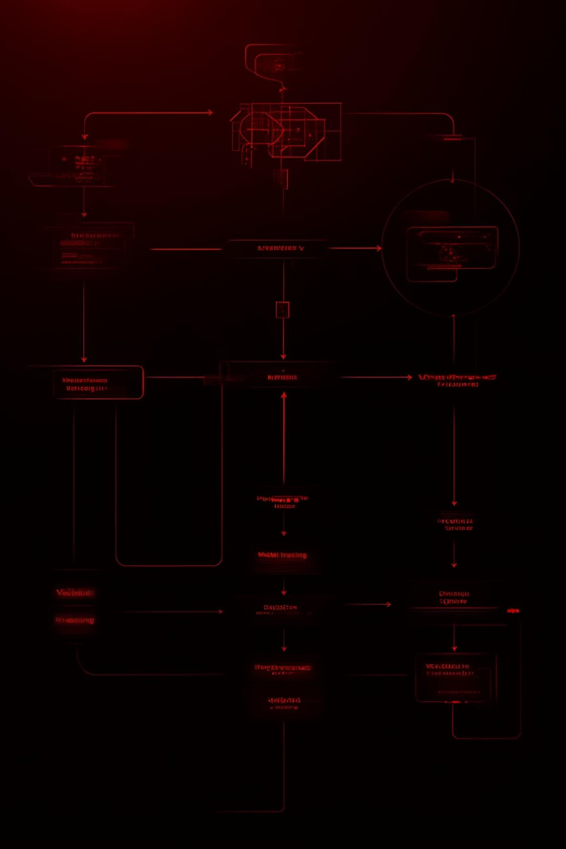




Building the Prediction Model: Step-by-Step
Data Preprocessing
Noise reduction, normalization, and augmentation prepare data. It enhances model quality.
Model Training
Fine-tuning the model using training data. It optimizes performance.
Validation
Assessing performance on a held-out set. It ensures generalization.
Performance Metrics
Accuracy, precision, recall, and F1-score evaluate effectiveness. They quantify model success.

Slide 7
Case Study: Real-World Application
Example: Predicting stroke risk in patients with atrial fibrillation.
Data: Anonymized patient records fueled the model. It ensured privacy.
Model: A CNN model achieved 92% accuracy. It demonstrated strong predictive power.
Outcome: Early intervention reduced stroke incidence by 30%. This highlights clinical impact.
This case study illustrates the tangible benefits of AI in healthcare. It saves lives and reduces suffering.

Slide 8








Challenges and Limitations
Data Quality
Generalizability
Ensuring high-quality and representative data is crucial. It impacts model reliability.
Overcoming biases and improving robustness is vital. It broadens applicability.
Computational Resources
Clinical Integration
Bridging the gap between AI and practice is essential. It ensures practical use.
Handling large datasets and complex models demands significant power. It requires robust infrastructure.

Slide 9



Ethical Considerations and Privacy
Data Privacy
Protecting patient confidentiality is paramount. We adhere to HIPAA regulations.
Bias Mitigation
Addressing biases in algorithms is critical. It ensures fairness.
Transparency
Ensuring interpretability and accountability is key. It builds trust.
Ethical AI development is fundamental for responsible innovation. We prioritize patient well-being.

Slide 10





The Future of Stroke Prediction
Advancements in AI
Personalized Medicine
Integrating sophisticated models and techniques will enhance predictions.
Tailoring predictions to individuals will revolutionize care.
Remote Monitoring
Impact
Wearable sensors will provide continuous risk assessment.
Improving patient outcomes reduces the burden of stroke.
The future of stroke prediction is bright. AI will transform proactive healthcare.

